Slide 1
Controlling computer using Hand gestures using arduino

Slide 2
motive
Recently Gesture controlled Laptops or computers are getting very famous. This technique is called Leap Motion which enables us to control certain functions on our computer/Laptop by simply waving our hand in front of it. It is very cool and fun to do it, but these laptops are really priced very high. So in this project let us try building our own Gesture control Laptop/Computer by combining the Power of Arduino and Python.

Slide 3
Basic idea
The concept behind the project is very simple. We will place two Ultrasonic (US) sensors on top of our monitor and will read the distance between the monitor and our hand using Arduino, based on this value of distance we will perform certain actions. To perform actions on our computer we use Python pyAutogui library. The commands from Arduino are sent to the computer through serial port (USB). This data will be then read by python which is running on the computer and based on the read data an action will be performed

Slide 4
Material used
One Arduino UNO
Two Ultrasonic Sensors
Jump Wires
LCD Screen
Breadboard
3.3 Kohm resistor or Potentiometer
2.2 Kohm resistor

Slide 5
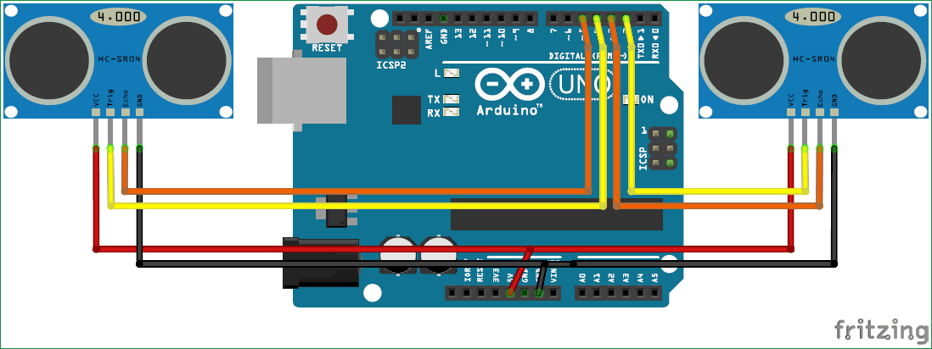
Circuit diagram

Slide 6
description
The Arduino should be programmed to read the distance of hand from the US sensor. By reading the value of distance we can arrive at certain actions to be controlled with gestures, for example in this program I have programmed 5 actions as a demo.
Action 1: When both the hands are placed up before the sensor at a particular far distance then the video in VLC player should Play/Pause.
Action 2: When right hand is placed up before the sensor at a particular far distance then the video should Fast Forward one step.
Action 3: When left hand is placed up before the sensor at a particular far distance then the video should Rewind one step.
Action 4: When right hand is placed up before the sensor at a particular near distance and then if moved towards the sensor the video should fast forward and if moved away the video should Rewind.
Action 5: When left hand is placed up before the sensor at a particular near distance and then if moved towards the sensor the volume of video should increase and if moved away the volume should Decrease.

Slide 7
.
We need to calculate the distance between the Sensor and the hand each time before concluding on any action. So we have to do it many times, which means this code should be used as a function. We have written a function named calculate_distance() which will return us the distance between the sensor and the hand.
Inside our main loop we check for the value of distance and perform the actions mentioned above. Before that we use two variables distL and distR which gets updated with current distance value
Since we know the distance between both the sensors, we can now compare it with predefined values and arrive at certain actions. For example if both the hands are placed at a distance of 40 mc then we play/pause the video. Here the word “Play/Pause” will be sent out through serial port
If the Right hand alone is placed before the module then we fast forward the video by one step and if it is left hand we rewind by one step. Based on the action, here the word “Rewind” or “Forward” will be sent out through serial port

Slide 8
.
Foe detailed control of volume and track we use a different methodology so as to prevent false triggers. To control the volume we have to place the left hand approx. At a distance of 15 cm , then you can either move it towards the sensor to decrease the volume of move it away from the sensor to increase the volume. The code for the same is shown below. Based on the action, here the word “Vup” or “Vdown” will be sent out through serial port
We can use the same method for the right side sensor also, to control the track of the video. That is if we move the right hand towards the sensor it will fast forward the movie and if you move it away from the sensor it will rewind the movie. Based on the action, here the word “Rewind” or “Forward” will be sent out through serial port
You can now read over the complete code for this gesture controlled PC given at the end of the page and try understating it as an whole and then copy it to your Arduino IDE.

Slide 9
Team for ic3
TEGHDEEP KAPOOR 18104050
TANYA PANDHI 18104064
DIVYAM SHRIVASTAVA 18104034

